Slide 1
Cleaning Data
Sean McMinn
American University – spring 2021

Slide 2
Data stories?

Slide 3
Steps to a data story
Find data
Clean data
Analyze data
Present data

Slide 4
Agenda
Why/when we need to clean data
Five cleaning activities
Advanced cleaning techniques using Sublime Text and Excel

Slide 5
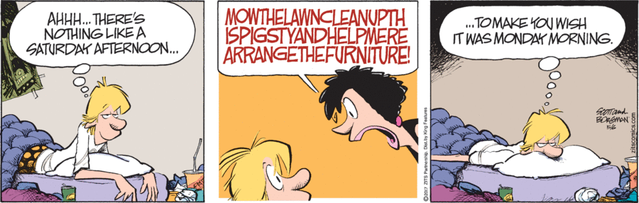
Data cleaning

Slide 6
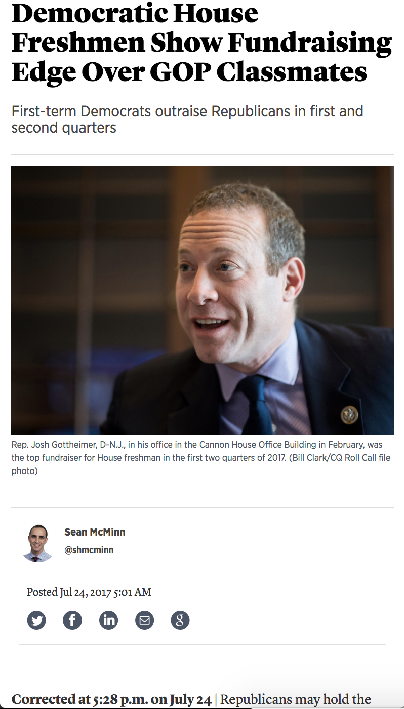
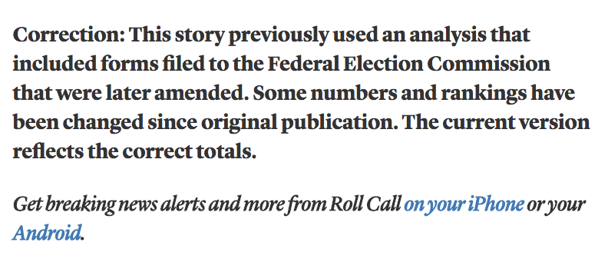
Data cleaning
Prevents this

Slide 7
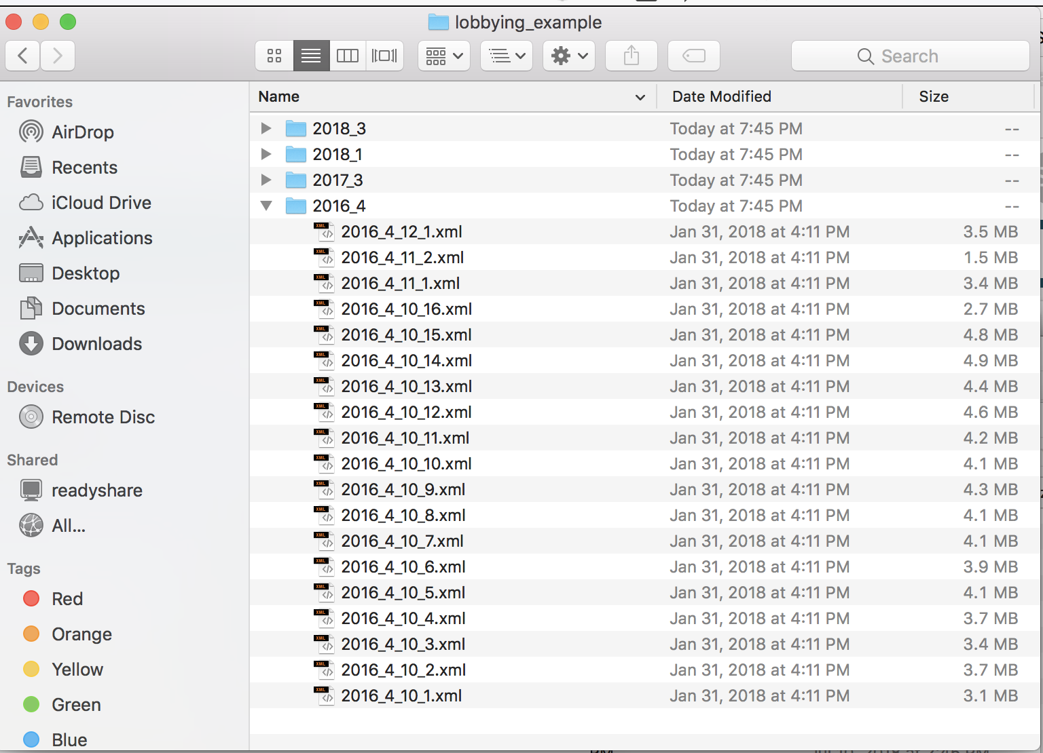
Data cleaning
And let’s you turn this

Slide 8
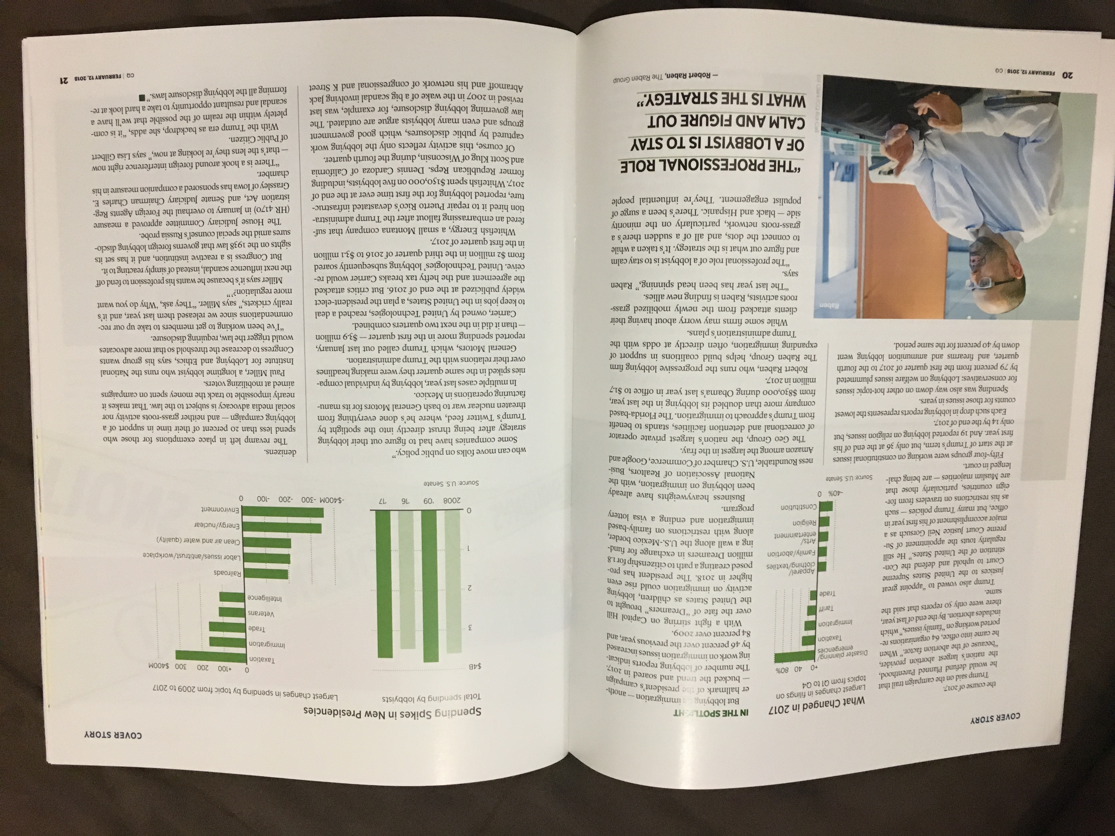
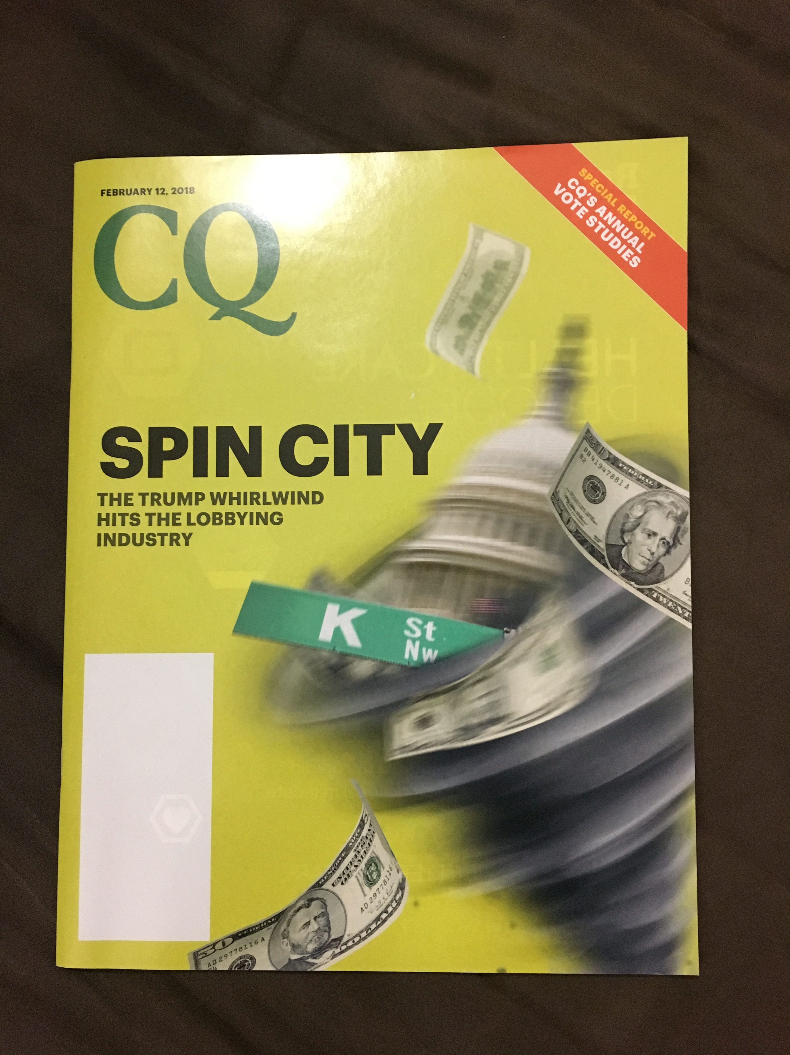
Data cleaning
Into this

Slide 9
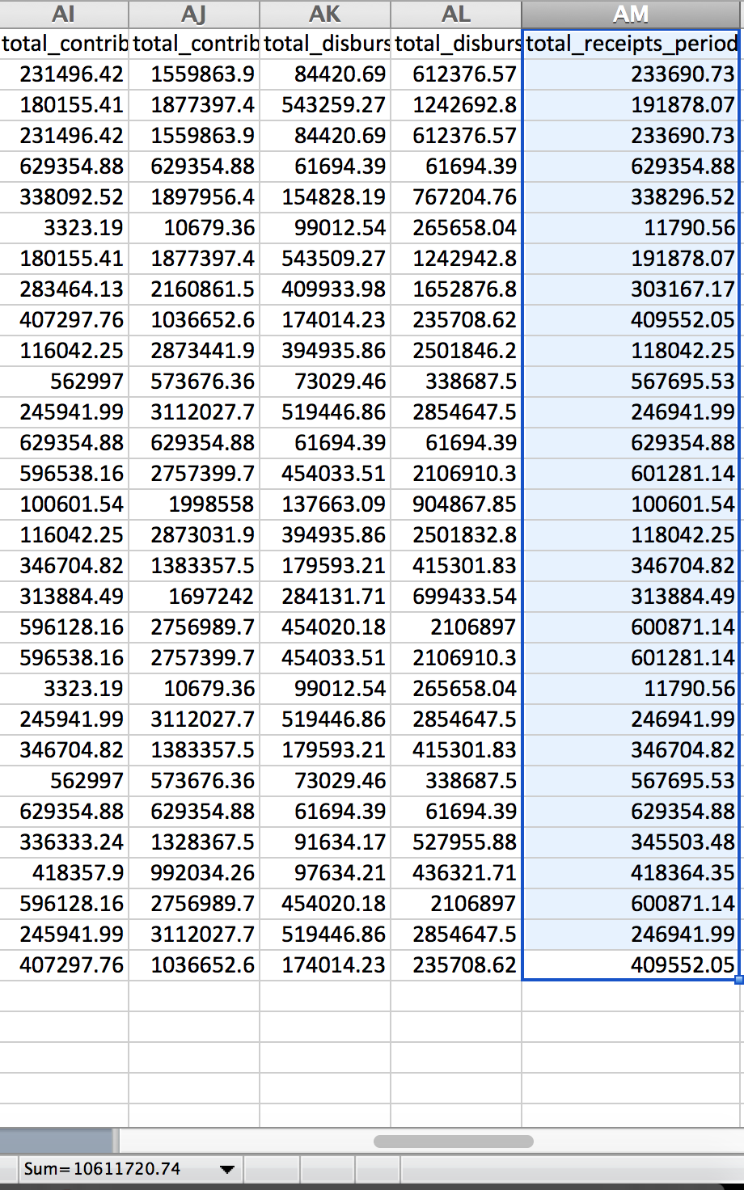
Data cleaning
How you can (read: I did) mess up if you don’t clean

Slide 10
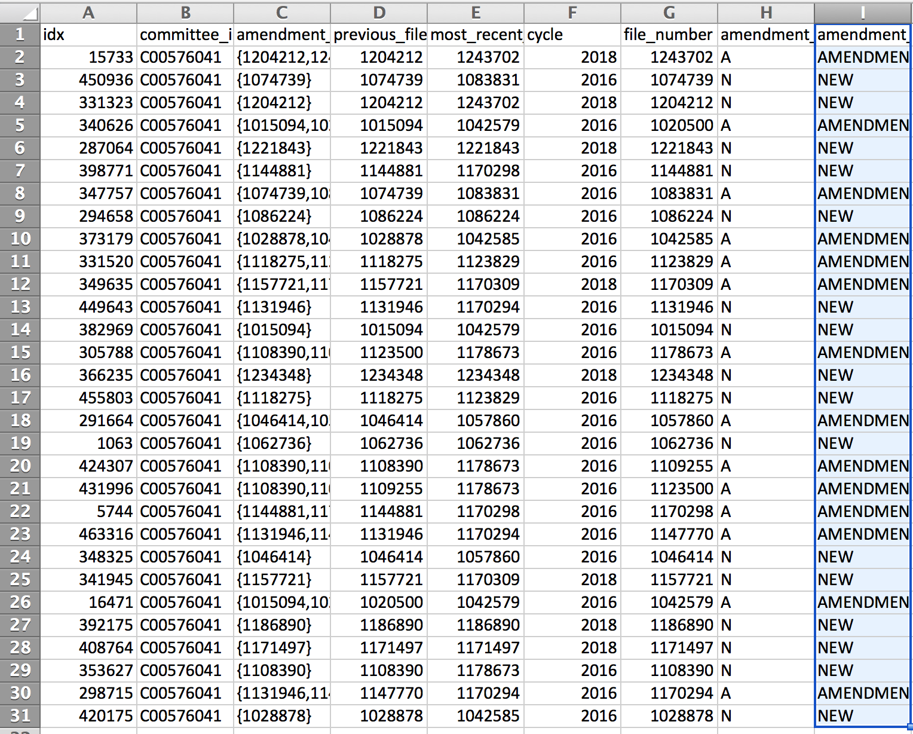
Data cleaning
How you can (read: I did) mess up if you don’t clean

Slide 11
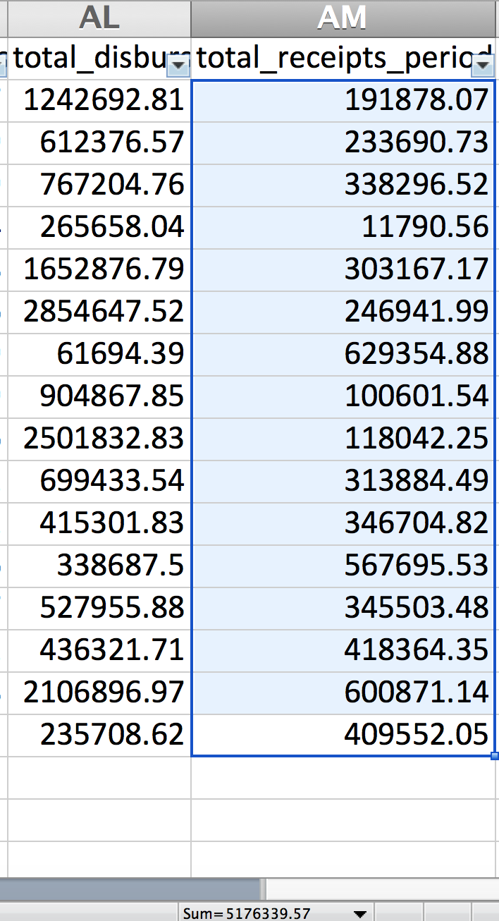
Data cleaning
How you can (read: I did) mess up if you don’t clean

Slide 12
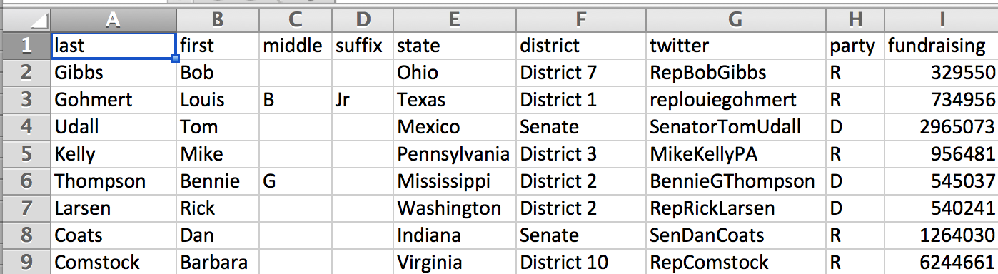
Data examples
“Good” (slash very fake) fundraising data

Slide 13
Data examples
“Good” (slash very fake) fundraising data
Separate fields in separate columns

Slide 14
Data examples
“Good” (slash very fake) fundraising data
Separate fields in separate columns
States and districts formatted the same

Slide 15
Data examples
“Good” (slash very fake) fundraising data
Clean numbers (no commas, $ signs)
Separate fields in separate columns
States and districts formatted the same

Slide 16
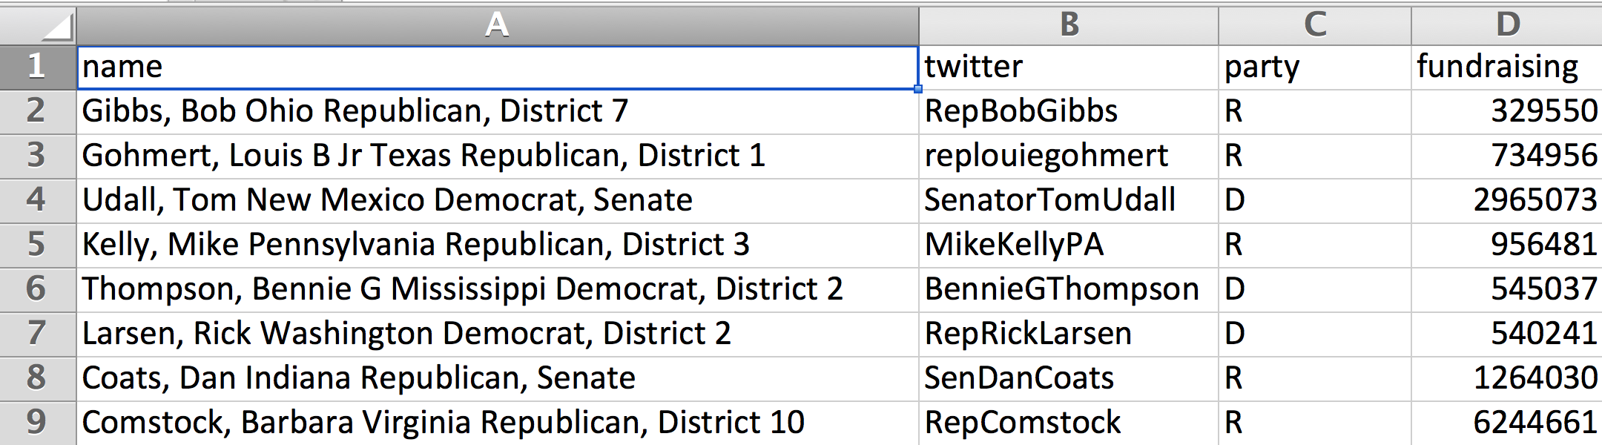
Data examples
How that data started out
Lots mashed together for each data point
Redundant column

Slide 17
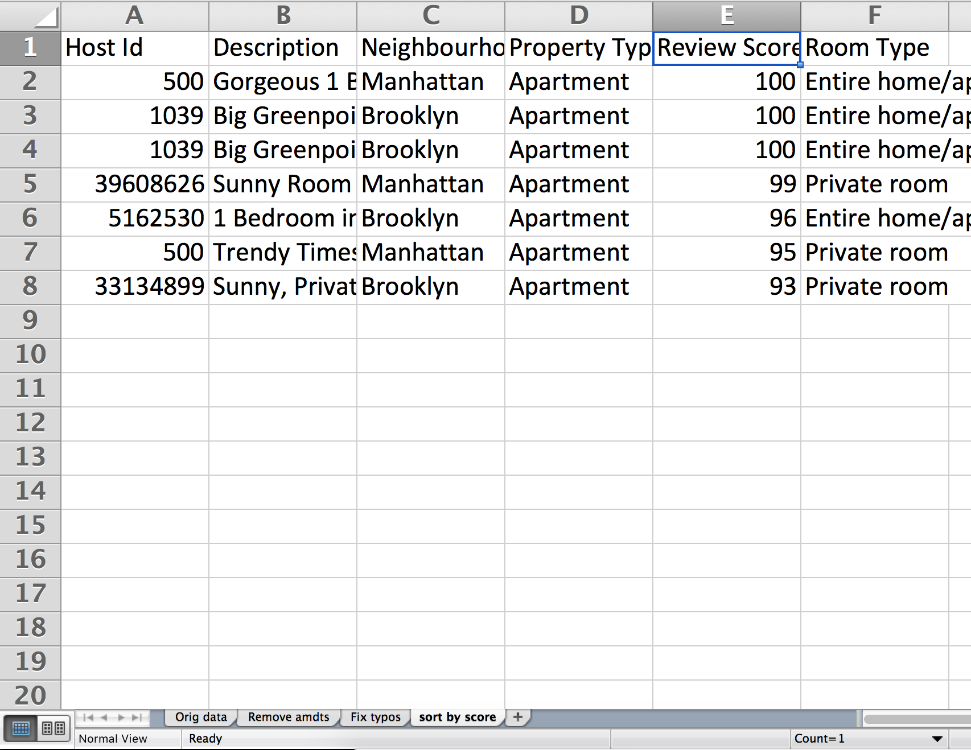
First, a word
Always work on a COPY of your data!
Always keep a RECORD of what you’re doing to your data
Example:

Slide 18

First, a word
Always work on a COPY of your data!
Always keep a RECORD of what you’re doing to your data
Example:

Slide 19
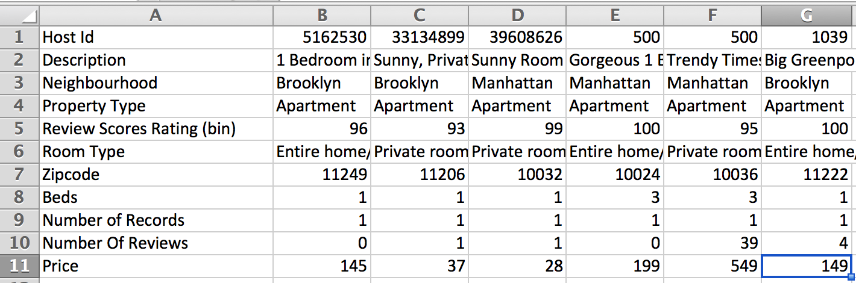
What to watch out for
Wrong-way (aka “fat”) data

Slide 20
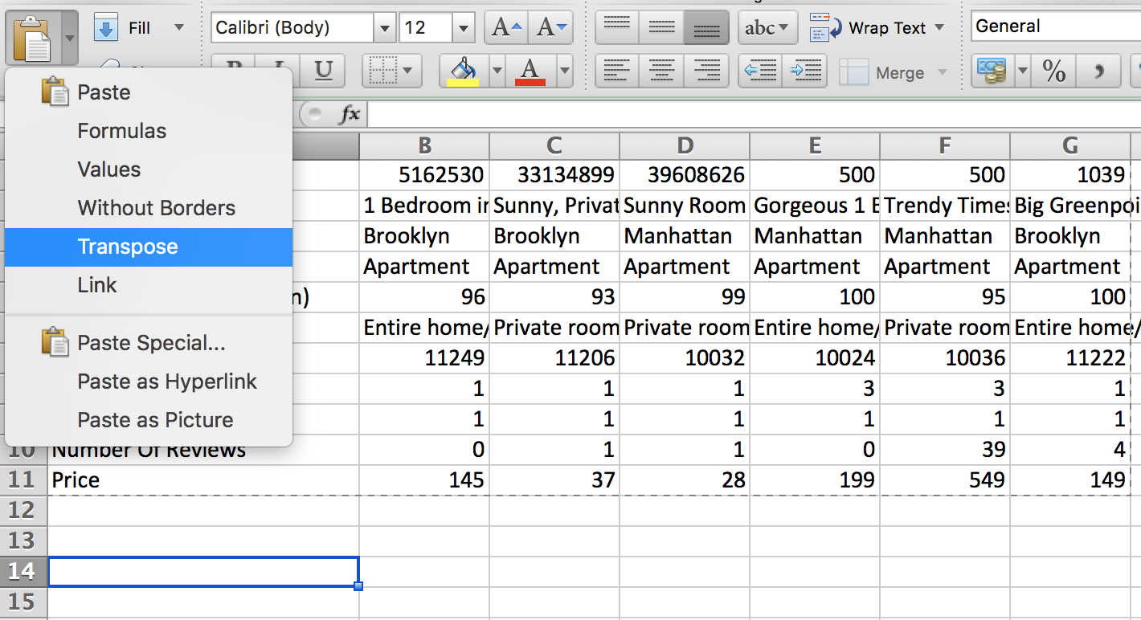
What to watch out for
Fix: Copy + Paste (transpose)

Slide 21
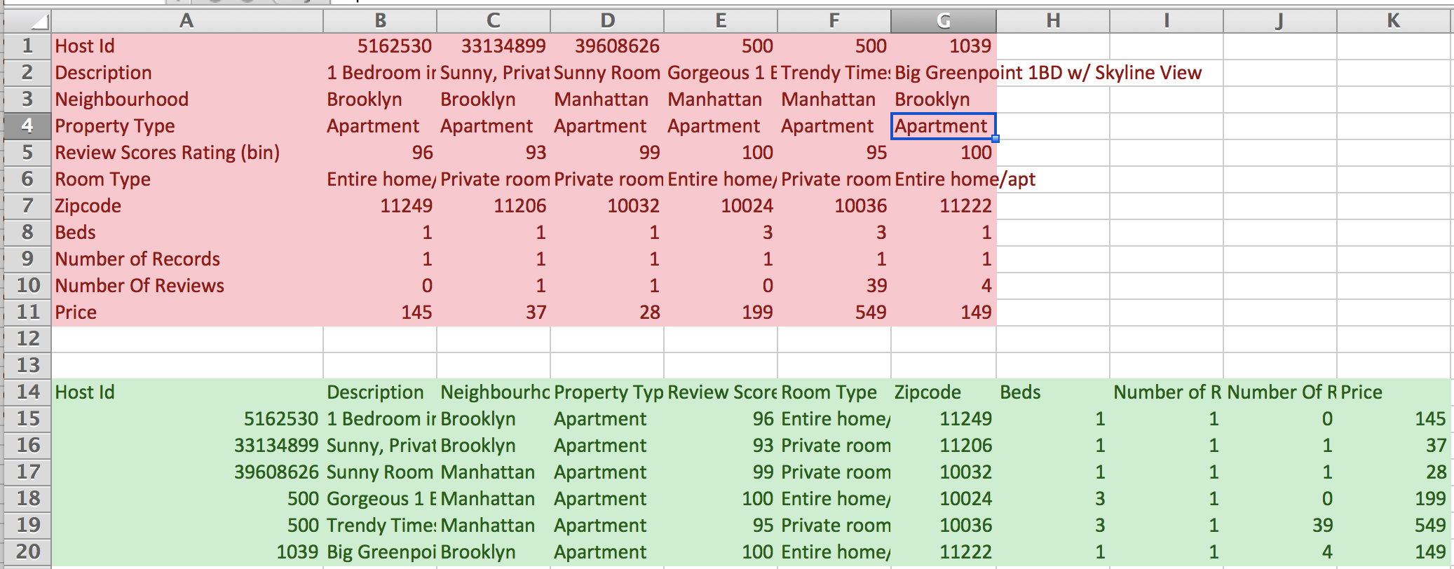
What to watch out for
Much better

Slide 22
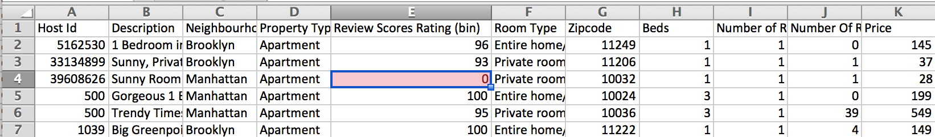
What to watch out for
Missing data
People will sometimes just BS what goes in there

Slide 23
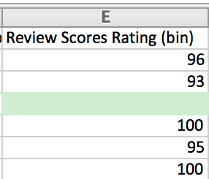
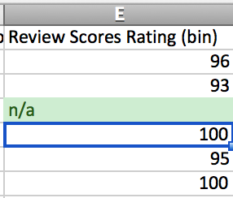
What to watch out for
Fix: Empty (or put in missing indicator)

Slide 24
What to watch out for
In pairs, clean this data
Airbnb-transpose-missing.csv

Slide 25
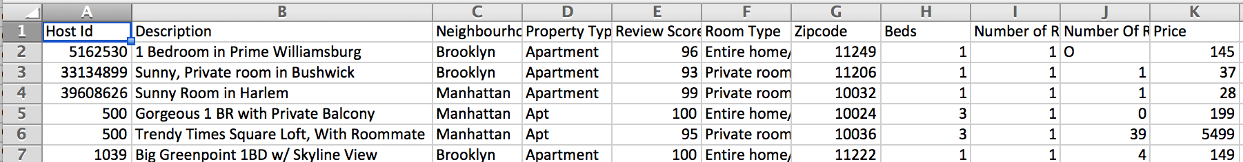
What to watch out for
Typos and/or data input inconsistency

Slide 26
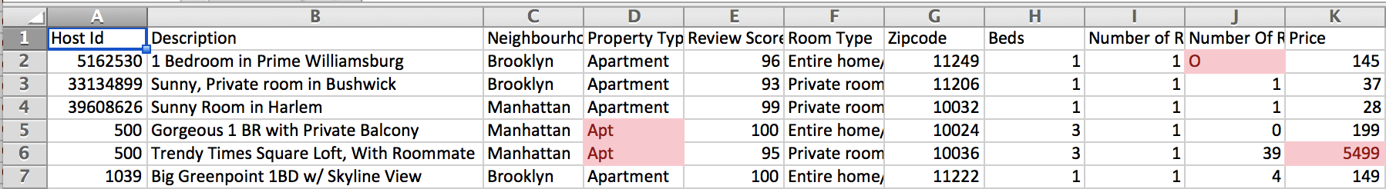
What to watch out for
Crazy outliers
Different formatting (letter O vs # 0)

Slide 27
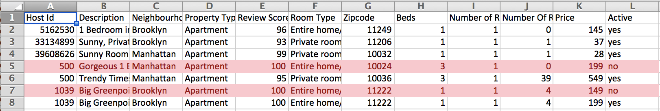
What to watch out for
Duplicates/amendments

Slide 28
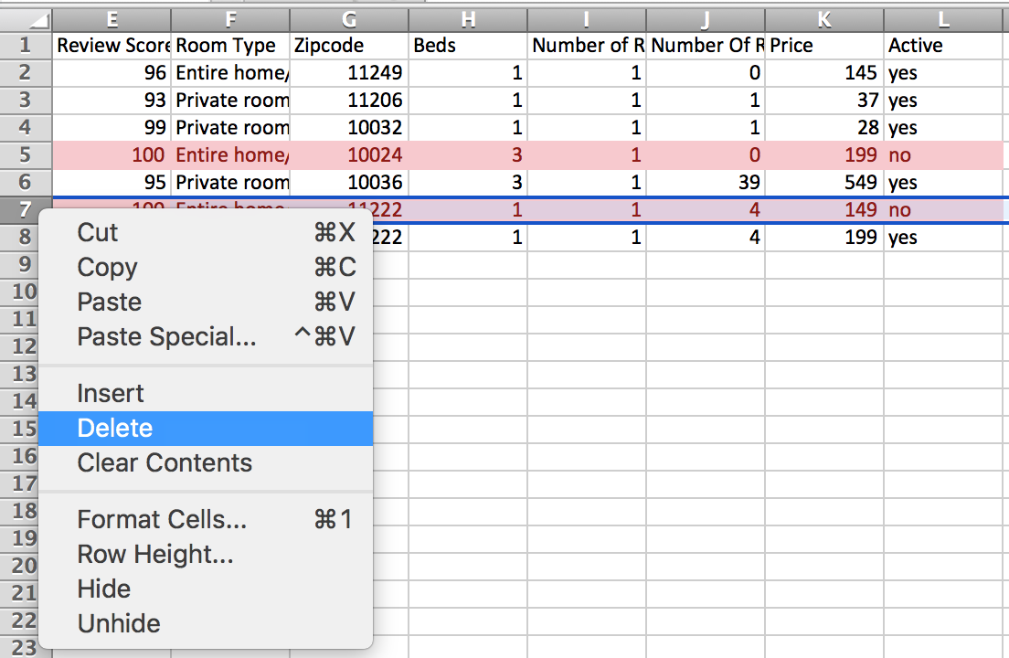
What to watch out for
Delete whole row by right clicking on row number

Slide 29
What to watch out for
In pairs, clean this data
airbnb-typos-amndmts.csv

Slide 30
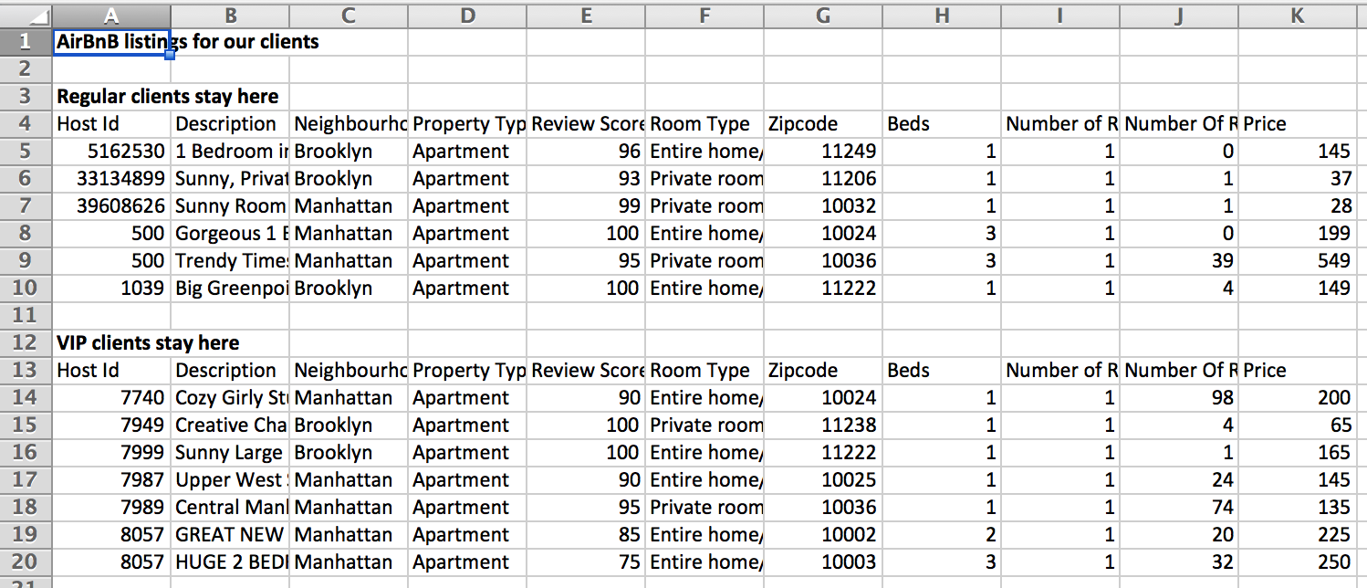
What to watch out for
Data broken into sections

Slide 31
What to watch out for
No need for title up top
Don’t want two headers
If groupings are important, add one (or more) data column(s)!

Slide 32
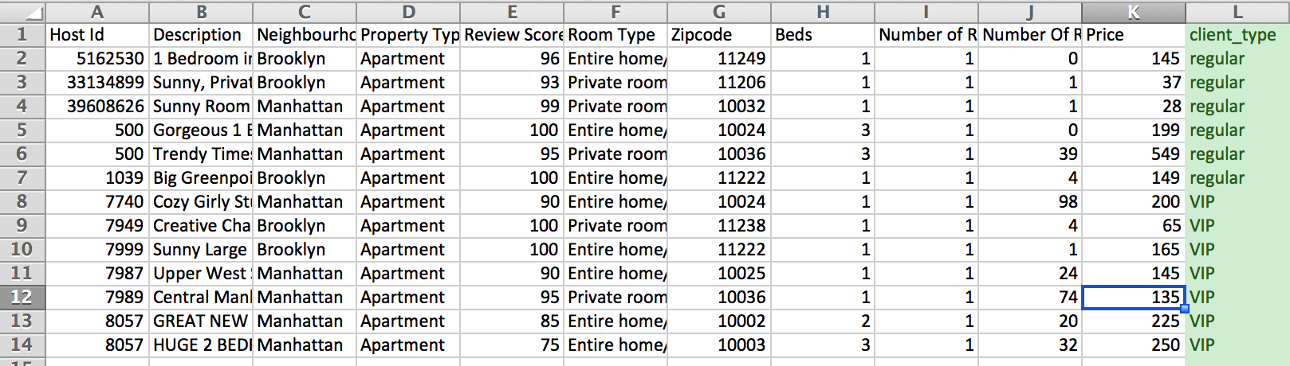
What to watch out for
Better ☺

Slide 33
What to watch out for
In pairs, clean this data
Airbnb-sections.csv

Slide 34
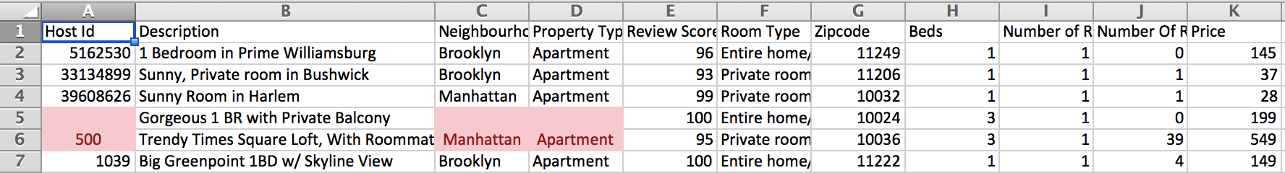
What to watch out for
Merged cells
People think they’re being ~*fancy*~
They’re not.
(They’re being dumb and should be ridiculed for it.)

Slide 35
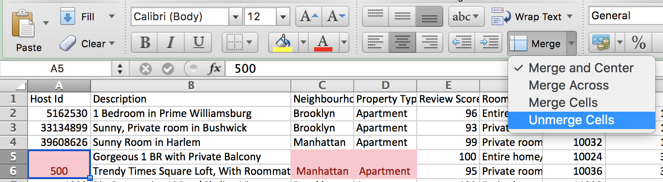
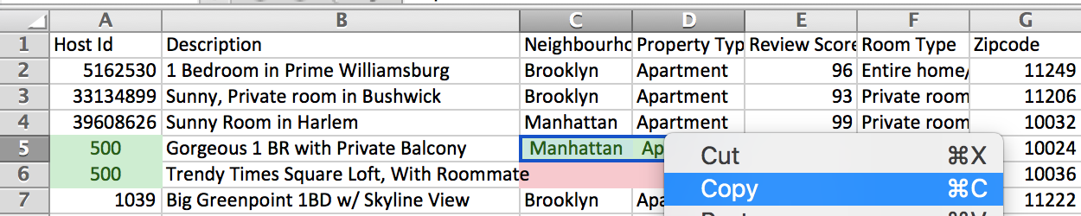
What to watch out for
Unmerge and copy the value to the blank cells

Slide 36
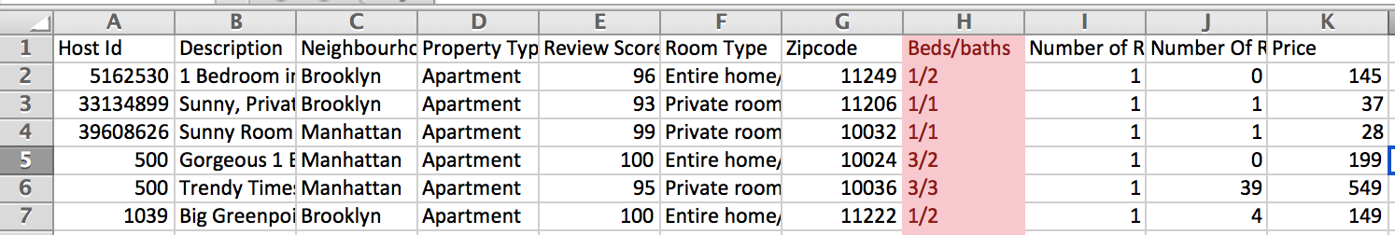
What to watch out for
Columns that should be split into two

Slide 37
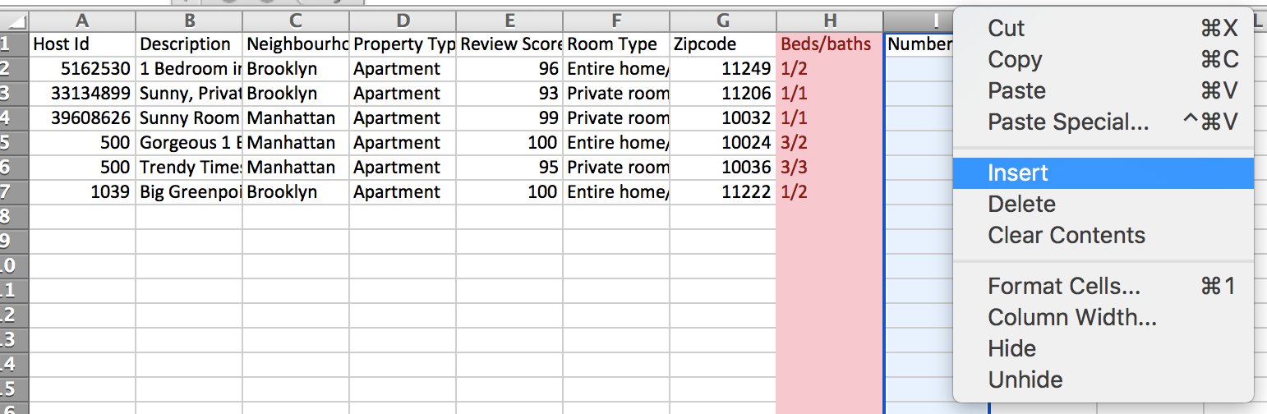
What to watch out for
Add a column next to it

Slide 38
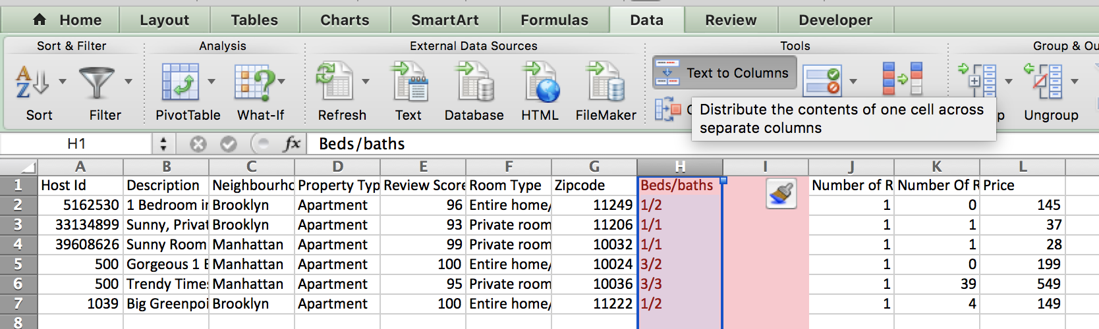
What to watch out for
Text to columns

Slide 39
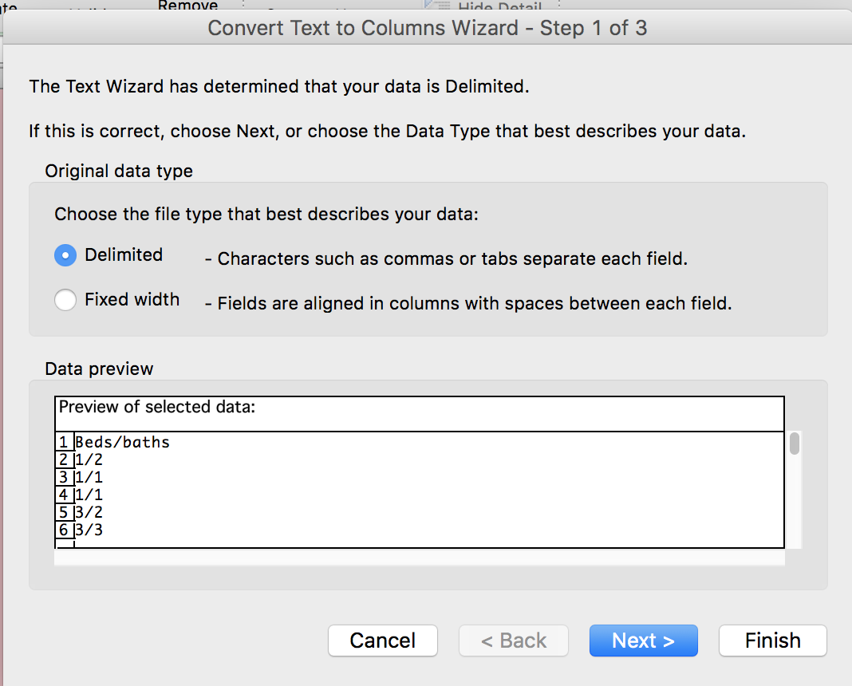
What to watch out for
Only works if data has a delimiter – something SEPARATING the data

Slide 40
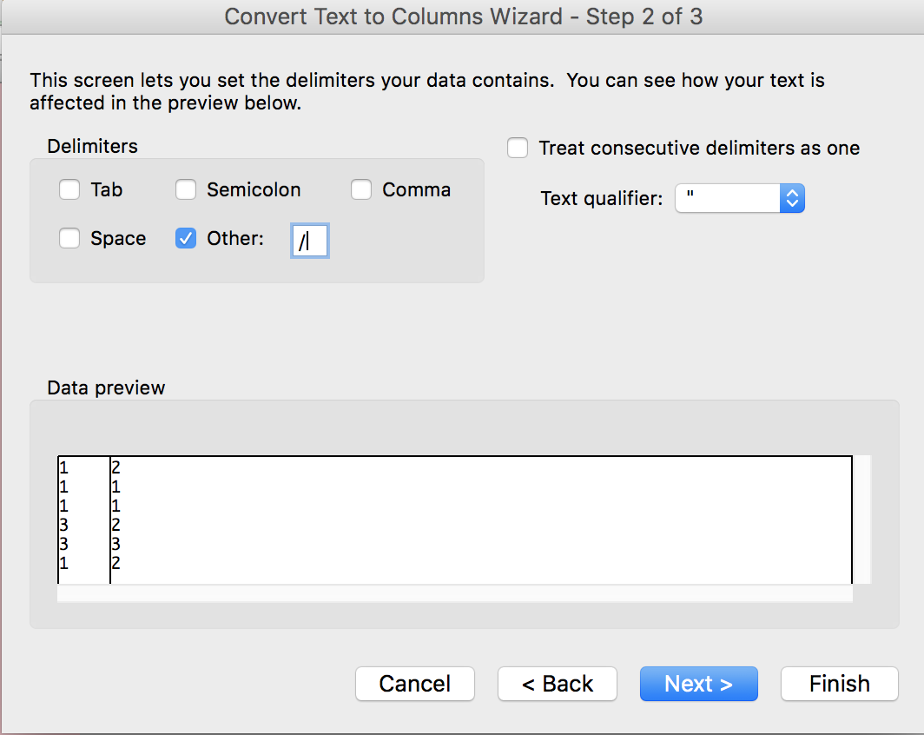
What to watch out for
Choose what your delimiter is

Slide 41
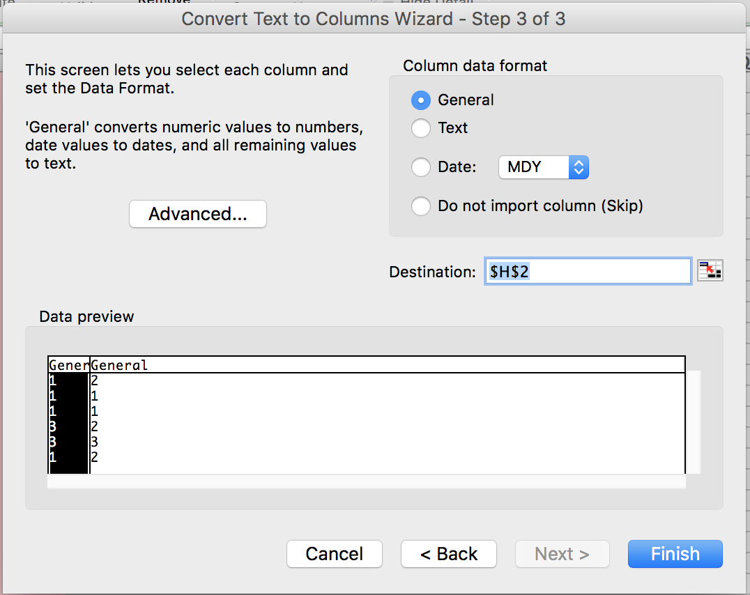
What to watch out for
Can leave this (puts data in same place)

Slide 42
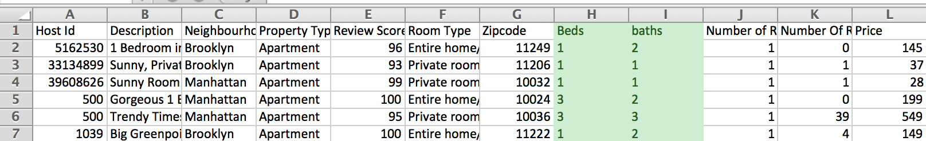
What to watch out for
Much better ☺

Slide 43
What to watch out for
In pairs, clean this data
Airbnb-cols.xlsx

Slide 44
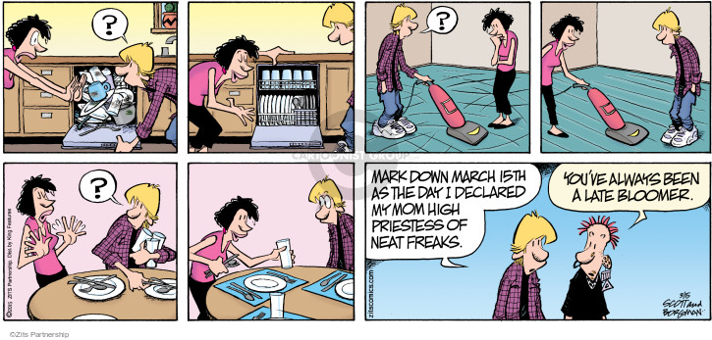
Cleaning techniques

Slide 45
Cleaning techniques
You can do everything by hand, one at a time, but UGH

Slide 46
Cleaning techniques
Filter then change
Marijuana lobbying data:
Org ➔ Organization
Marijuana-lobby-namechange.csv

Slide 47
Cleaning techniques
Find and replace
Marijuana lobbying data:
Org ➔ Organization
Marijuana-lobby-namechange.csv

Slide 48
Cleaning techniques
ADVANCED find and replace
a.k.a. regular expressions
a.k.a. regex
a.k.a. misleadingly intimidating pile of garbage
^".*" or \n[A-Za-z]*\t or : "\d* "

Slide 49
Cleaning techniques
dc-crimes-search-results-tenley.csv
Make own column for TIME off of REPORT_DAT
Prepend zero to times between 0:00 and 9:59

Slide 50
Cleaning techniques
Assignment 3
Find a dataset to clean and document your steps

